Slide 1
TRADING ACTION CLASSIFICATION
By: Quang Lam, Thu Pham

Slide 2

Introduction
Data Source
Data Overview
Model Implementation
Report Poster

Slide 3
INTRODUCTION
Our purpose is to utilize machine learning to predict stock trading action (long position/short position) in the monthly-basis.
Our model is currently applied to a single stock symbol.
Notes:
Having a “long” position in a security means that you own the security. Investors maintain “long” security positions in the expectation that the stock will rise in value in the future.
A "short" position is generally the sale of a stock you do not own. Investors who sell short believe the price of the stock will decrease in valu

Slide 4

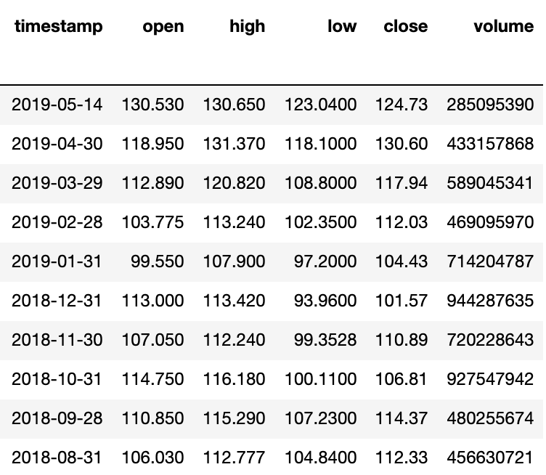
DATA SOURCE
Stock Price
Alpha Vantage API
Monthly
Since 2000

Slide 5
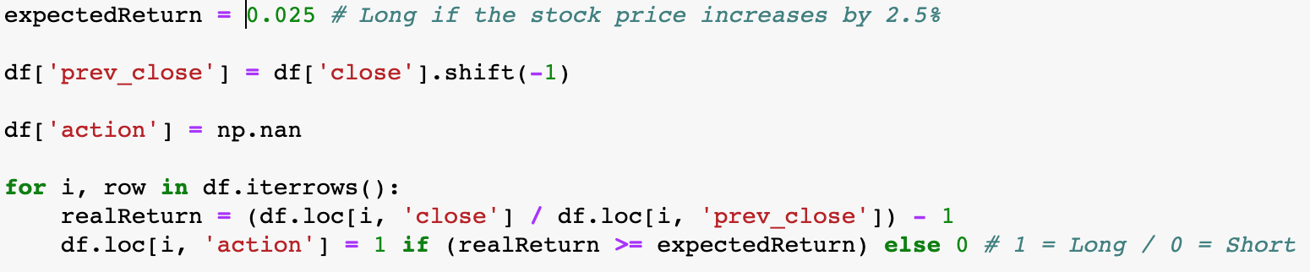
DATA SOURCE
Convert the dataset to classification data
Long (1) if the stock price increases by a threshold. Short if otherwise.

Slide 6

DATA SOURCE
Sentimental Analysis
New York Times API

Slide 7

2,172,712
headlines

Slide 8
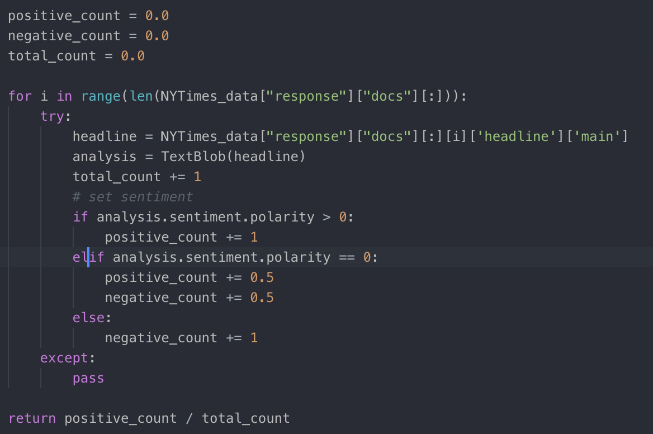
DATA SOURCE
Sentimental Analysis
Assign a positive/negative value to each headline.
Calculate the percentage of positive headline each month.

Slide 9
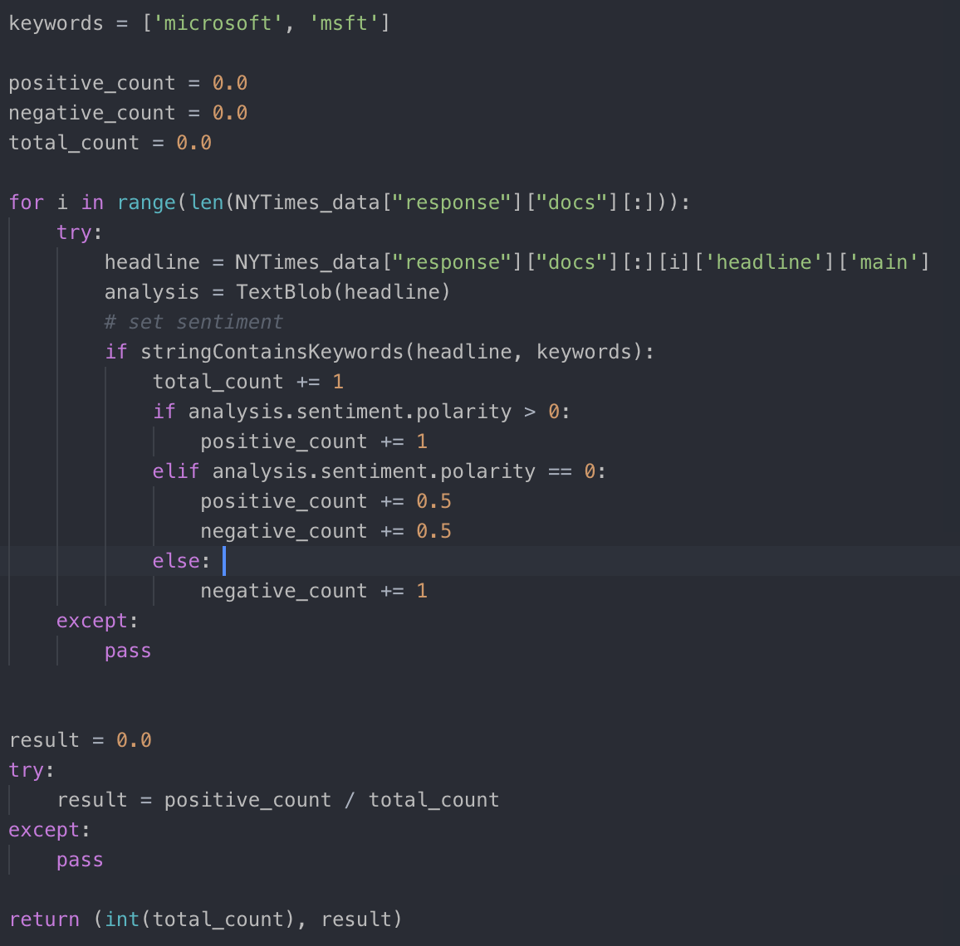
DATA SOURCE
Sentimental Analysis
Pick out the headline related to the stock symbol.
Assign a positive/negative value to each headline.
Count the number of company appearance on news.
Calculate the percentage of positive appearance each month.

Slide 10
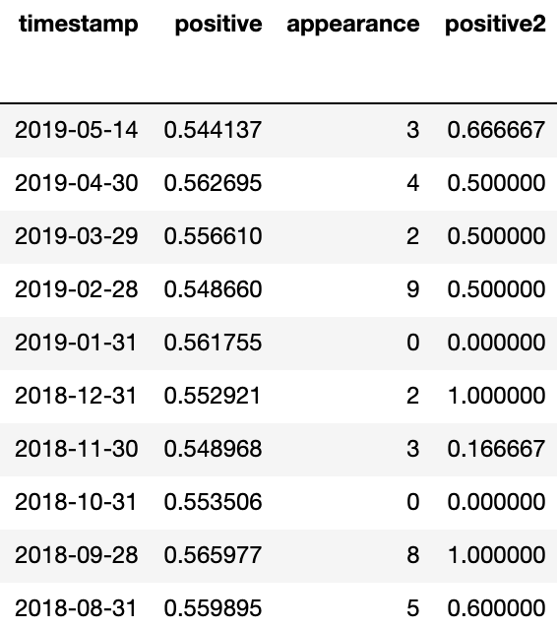
DATA SOURCE

Slide 11

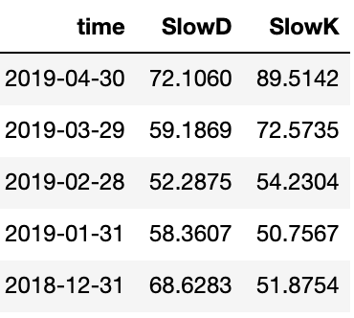
Data Overview
STOCH
Stochastic oscillator is a momentum indicator comparing a particular closing price of a security to a range of its price over a period of time.
SlowK
SlowD
Notes:
1. %K, also known as “stochastic fast”, tracks the current market rate for the currency pair.
2. %D, known as the signal line, typically uses the last three valuations of %K to create a moving average of the %K stochastic. Because %D is a moving average of %K, it is referred to as "stochastic slow"since it reacts more slowly to market price changes than %K.
Useful to provide insight into potential future market direction.

Slide 12
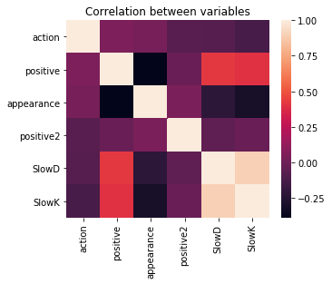
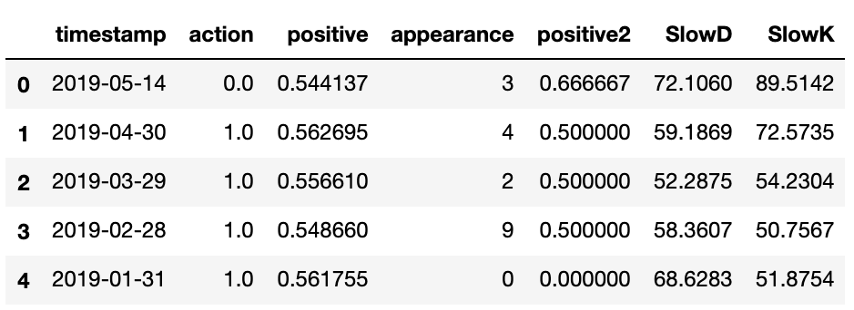
Data Overview

Slide 13

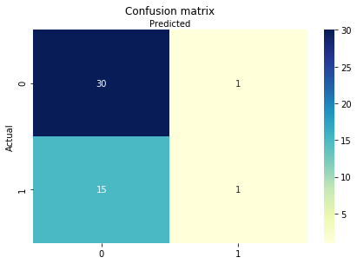
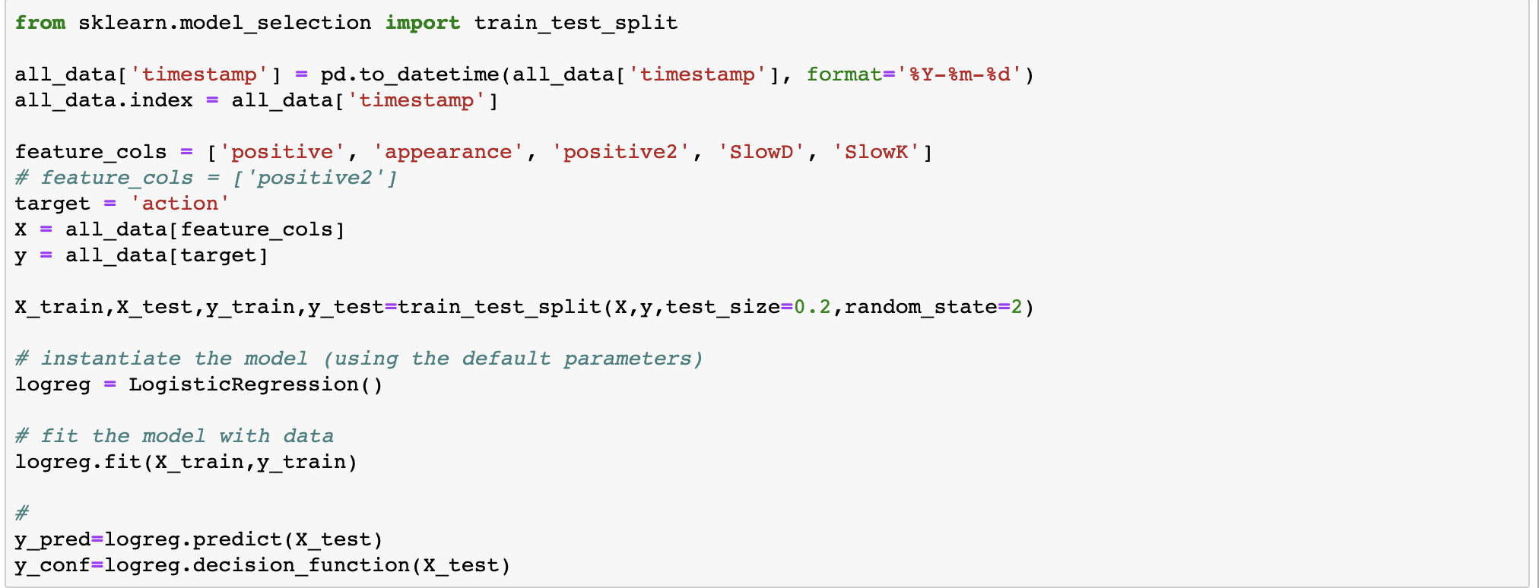
MODEL IMPLEMENTATION
Logistic Regression
Accuracy: 0.6595744680851063
Notes:
Quang

Slide 14
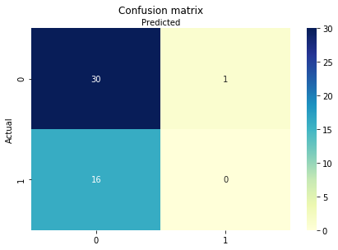
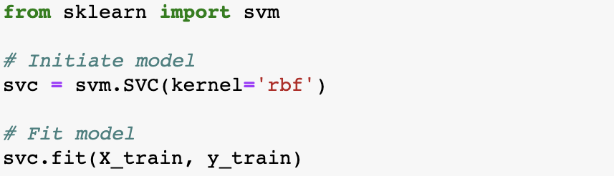
MODEL IMPLEMENTATION
Support Vector Machine
Accuracy: 0.6382978723404256
Notes:
Thu

Slide 15
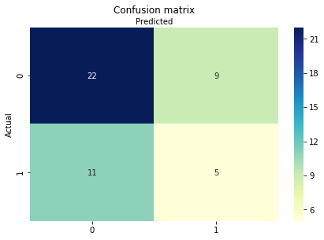
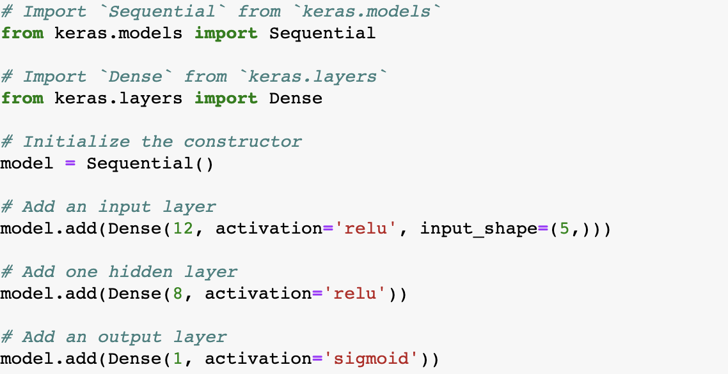
MODEL IMPLEMENTATION
Sequential Kernel
Accuracy: 0.574468085106383
Notes:
Thu

Slide 16
Trading Action Classification using Machine Learning
Quang Lam | Thu Pham
Luther College, Department of Computer Science & Data Science
ABSTRACT
DATA PREPROCESSING
RESULT
Stock prices fluctuate within seconds and are affected by complicated financial and non-financial indicators. Hence, stock prices prediction is an ambitious project. However, thanks to Machine Learning techniques, we have the capacity of classify trading action from massive amounts of data that capture the underlying stock price dynamics.
To preprocess the stock market price historical data, we set an expected return value (for example, 2.5%), which is minimal change in the stock price compared to the previous month for a long position. With this threshold value, we add a new variable called action with 2 values: 1 represents long position and 0 represents short position.
Then we use sentimental analysis to analyze the New York Times headlines and add 3 variables: positive represents the percentage of positive headlines, appearance and positive2 represents the number of times the company appears on the news and the percentage of its positive appearance.
Then STOCH variables and the three mentioned variables are matched with upcoming month while action variable is matched with its real month. It means we would use other variables to predict what to do the upcoming months (action).
The correlation of our completed dataset is shown below, using heatmap:
The models successfully predict the actions at least 55% of the time with the expected return value close to 0. The expected return value significantly affects the accuracy of the models. The smaller the expected return value, the more likely the decision making fluctuates with the market, so the more least accurately the models predict.
METHODOLOGY
Logistic Regression (LR)
Logistic regression is a simple linear model for classification. The accuracy of this method is approximately 66%. The confusion matrix is presented below:
CONCLUSION
INTRODUCTION
As the models only predict between two values: long position or short position, we consider the accuracy of our trained models is not sufficient enough to use in the real world.
With the results of this project, even though we intend to analyze the dataset in the monthly basis instead of daily or weekly to minimize to volatility, we conclude that the stock market is much more volatile than we expected and cannot be predicted accurately using the sentimental analysis of news headline but requiring additional data and methods. Also, our dataset in monthly basis is too small to train the value thoroughly.
Additionally, as we analyze the dataset using three different Machine Learning methods, including one using complex neutral networks, the results are not much different between them. So we conclude that the methodology of our project is not the primary factor of its inaccuracy.
To improve the results, we suggest adding new variables to the models, analyzing the data in the weekly-basis to have more breakpoints for the models to adjust to the volatile market.
In this project, we utilized past data, technical indicators, and economic indexes and applied supervised learning methods to predict stock price action trading (long position/short position) on the next trading month.
As opposed to predicting the trend in short-term which is used in the high-frequency trading market, we intend to forecast the upward and downward movement in the weekly-basis not solely for algorithmic trading, but as a supplement to help investors alike on decision-making.
Our model is currently applied to a single stock symbol.
DATA SOURCE
The project uses the free API from Alpha Vintage (alphavantage.co) to the monthly stock market price historical data in the past 20 years.
Additionally, Alpha Vintage also provides the STOCH index data. By definition, stochastic oscillator is a momentum indicator comparing a particular closing price of a security to a range of its price over a period of time.
Most importantly, the project uses the New York Times Articles API to retrieve all the news headlines New York Times published since January 2000.
Support Vector Machine (SVM)
Similar to Logistic Regression, SVM is an algorithm used for classification problems. However, in large dataset, SVM performs marginally better and less sensitive to outliers than LR. In our case, this dataset is considered not big, we do not see an improvement in performance when applying SVM. The accuracy of SVM is approximately 64%.
Neural Networks
Since we are performing binary classification, a multi-layer perceptron is an appropriate method for such model. We implement a Dense layer, which is a connect layer. The first two layers take activation argument ‘relu’ while the last layer takes ‘ stigmoid’ . The accuracy of this model is roughly 57%
ACKNOWLEDGEMENT
Thank you Professor Shafqat Shad and Professor Kent Lee, our instructors, for your support and instructions throughout this project.
We acknowledge the research papers we use to help us conduct this project (available at the link below)
The project is available at: github.com/thu2pham/StockForecasting

Slide 17
THANKS!
Any questions?
Notes:
Thu

